Slide 1
QUALIFICATIONS OF FORENSIC SCIENTISTS
Abhishek Prajapati
Research Scholar
National Forensic Sciences University Gandhinagar

Slide 2
WHO IS A FORENSIC SCIENTIST?
A forensic scientist uses knowledge of science (chemistry, biology, physics, digital science, etc.) to examine evidence and present it in a form that courts and investigators can understand.
Forensic science applies scientific methods to solve criminal mysteries.
Forensic experts assist law enforcement in:
Crime scene investigation
Evidence collection and analysis
Linking suspects to crimes
Specializations include: Ballistics, Toxicology, DNA analysis, Fingerprint analysis, and Digital crimes.
They prepare reports for courts to ensure justice.

Slide 3
BECOMING A FORENSIC SCIENTIST: QUALIFICATIONS & EDUCATION PATH
Schooling: Pass Class 10 & 12 (Science stream) with ≥55% marks.
Undergraduate Degree: B.Sc. / B.Tech in Forensic Science, Biochemistry, Genetics, Biomedical Science, Policing Studies, etc. (≥50% marks).
Postgraduate & Doctorate Options:
M.Sc. / M.Tech in Forensic Science, Criminology, Human Anatomy, Forensic Law, etc.
M.Phil. / PhD in specialized forensic fields.
Specialized Training: Focus on fields like Toxicology, Ballistics, DNA Analysis, Fingerprint Examination, Blood Stain Analysis, Document Examination, Anthropology, Psychology, etc.

Slide 4
EMPLOYMENT OPPORTUNITIES FOR FORENSIC EXPERTS
Private Sector: Private detective agencies, Cellmark Forensics, Illumina INC., Promega CO., Sorenson Forensics, Private Law Firms
Government Sector: Intelligence Bureau, CBI, Police Departments, Government Forensic Labs & Hospitals, Defence, Banks, State Medical Colleges
Entry: Forensic laboratory analyst, crime scene investigator, digital forensic associate.
Growth: Senior forensic scientist, forensic expert, consultant for law enforcement, or court-appointed expert witness.
High level: Director of Forensic Lab, Research Scientist, or Government Forensic Advisor.

Slide 5
ESSENTIAL SKILLS FOR FORENSIC SCIENTISTS
Strong analytical and critical thinking skills to interpret evidence.
Attention to detail for accurate examination of cases.
Proficient examiner skills for investigating evidence.
Ability to work under pressure and meet strict deadlines.
Excellent communication skills to present findings to law enforcement and courts.

Slide 6
CAREER OPPORTUNITIES IN FORENSIC SCIENCE
Crime Scene Investigator (CSI)
Crime Scene Analyst
Crime Scene Technician
Evidence Technician
Forensic Examiner / Forensic Scientist / Forensic Specialist
Fingerprint Examiner
Crime Laboratory Analyst
Build a strong foundation by understanding the course curriculum and targeting organizations offering growth opportunities in the forensic field.

Slide 7
REFERENCES
https://leverageedu.com /blog/forensic-scientist/
https://www.forbes.com/ advisor/education/science/how -to-become-a-forensic-scientist/
https://www.edumilestones .com/career-library/How-to -become-a-Forensic-Scientist- in-India-Career-Guidance
Step-by-Step Guide to Pursuing a Career in Forensic Science

Slide 8
WHAT IS A FORENSIC SCIENTIST?
Applies scientific methods to analyze and interpret physical evidence in criminal investigations.
Works in laboratories, specializing in areas like DNA analysis, toxicology, ballistics, and trace evidence.
Examines evidence to provide critical insights for solving crimes, including identifying perpetrators and reconstructing crime scenes.
Uses advanced technologies to deliver accurate and reliable information that supports the legal system and pursuit of justice.

Slide 9
DUTIES AND RESPONSIBILITIES
Crime Scene Investigation: Collect, document, and preserve evidence; analyze patterns and conditions relevant to the investigation.
Evidence Analysis: Examine biological samples (DNA), chemicals, drugs, firearms, digital data, and more using advanced lab techniques and equipment.
Report Generation: Prepare detailed reports documenting methods, results, and interpretations to support legal proceedings.
Expert Witness Testimony: Present and explain forensic findings in court and assist in preparing legal documents.

Slide 10
Quality Control & Assurance: Ensure accuracy, reliability, and reproducibility of analyses while staying updated on new methodologies.
Collaboration: Work with forensic scientists, law enforcement, and related experts to integrate findings.
Specialized Expertise: Focus on areas like DNA, toxicology, trace evidence, digital forensics, or other specialized fields.
Ethical Standards: Maintain integrity and impartiality in all forensic analyses.
Research & Development: Develop new techniques and improve forensic methodologies to advance the field.

Slide 11
TYPES OF FORENSIC SCIENTISTS
Medical & Biological Experts:
Forensic Pathologist: Determines cause/manner of death, performs autopsies, provides court testimony.
Forensic DNA Analyst: Analyzes DNA to identify individuals and link suspects to crime scenes.
Forensic Toxicologist: Detects drugs, poisons, or toxins in biological samples.
Forensic Serologist: Analyzes blood and bodily fluids for criminal investigations.
Forensic Anthropologist: Studies human remains to determine age, sex, and identity.
Forensic Entomologist: Uses insect activity to estimate time since death.
Forensic Odontologist: Examines dental evidence like bite marks for identification.

Slide 12
Crime Scene & Evidence Experts:
Forensic Science Technician: Collects, analyses, and preserves physical evidence.
Forensic Chemist: Analyses drugs, explosives, and chemical substances.
Forensic Ballistics Expert: Examines firearms, bullets, and gunshot residue.
Forensic Document Examiner: Determines authenticity of docs, handwriting, & signatures.
Forensic Fire Investigator: Determines cause and origin of fires.
Digital Forensics Analyst: Analyses digital evidence from computers, phones, and networks.

Slide 13
Behavioural & Specialized Experts:
Forensic Psychologist: Assists in profiling, behavioural analysis, and competency evaluations.
Forensic Linguist: Analyses language in written or spoken communication.
Forensic Engineer: Investigates accidents, product failures, and structural issues.

Slide 14
WORKPLACE OF A FORENSIC SCIENTIST
Crime Laboratories: Analyze DNA, fingerprints, toxicology samples, and other evidence using state-of-the-art equipment.
Law Enforcement Agencies: Work with investigators at crime scenes and laboratories to collect and process evidence.
Government Agencies: Employed by agencies like FBI or DEA for high-profile or specialized investigations in secure environments.
Private Consulting Firms: Serve as expert witnesses or consultants, often with flexible schedules and varied cases.
Academic Institutions: Engage in research, teaching, and collaboration with other professionals.
Key Skills Across Workplaces: Adhere to ethical standards, follow legal protocols, maintain attention to detail, communicate effectively, and work under pressure.
REFERENCES
What does a forensic scientist do? - CareerExplorer

Slide 15
TOOLS & TECHNIQUES IN FORENSIC SCIENCE
1. Forensic science tools are specialized instruments used to gather, analyze, and interpret evidence.
2. They ensure accuracy and reliability in legal proceedings.
3. Help in identifying suspects, reconstructing events, and validating testimonies.

Slide 16
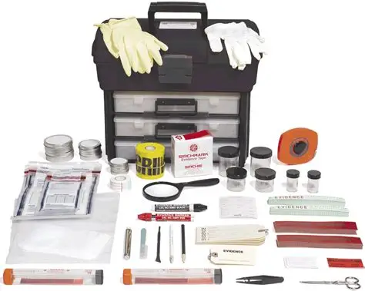
COLLECTION & PRESERVATION TOOLS
• Evidence kits (gloves, swabs, containers)
• Sealable bags & tamper-proof tags
• Temperature-controlled storage
• Prevents contamination & preserves integrity

Slide 17
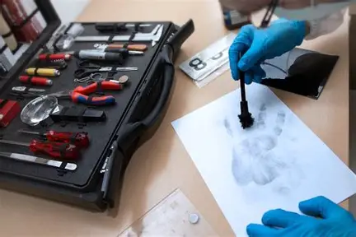
FINGERPRINT EXAMINATION DEVICES
Fingerprint scanners
High-resolution imaging
Automated matching software
Latent print capture from surfaces
AFIS integration for database comparison
Links suspects to crime scenes

Slide 18
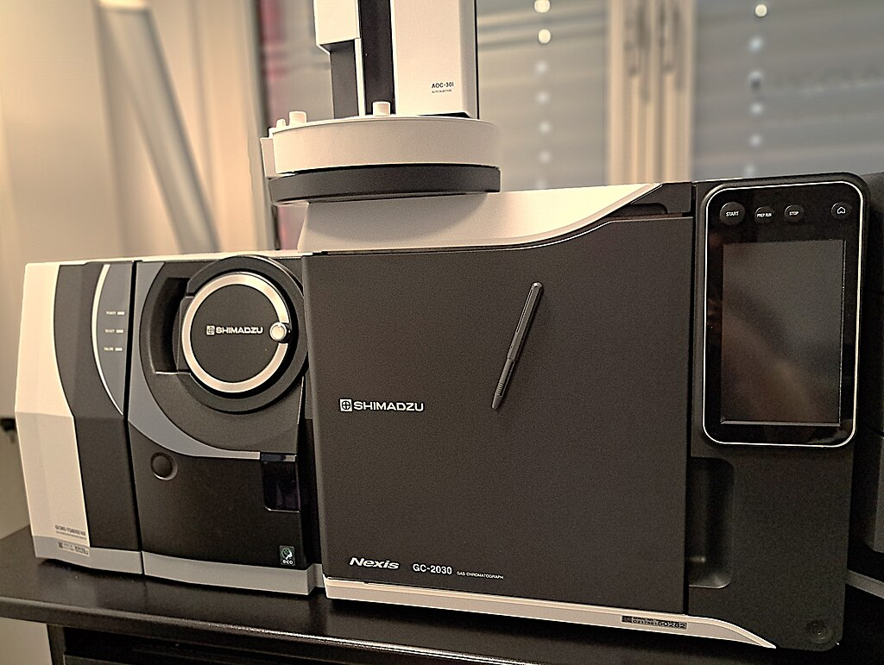
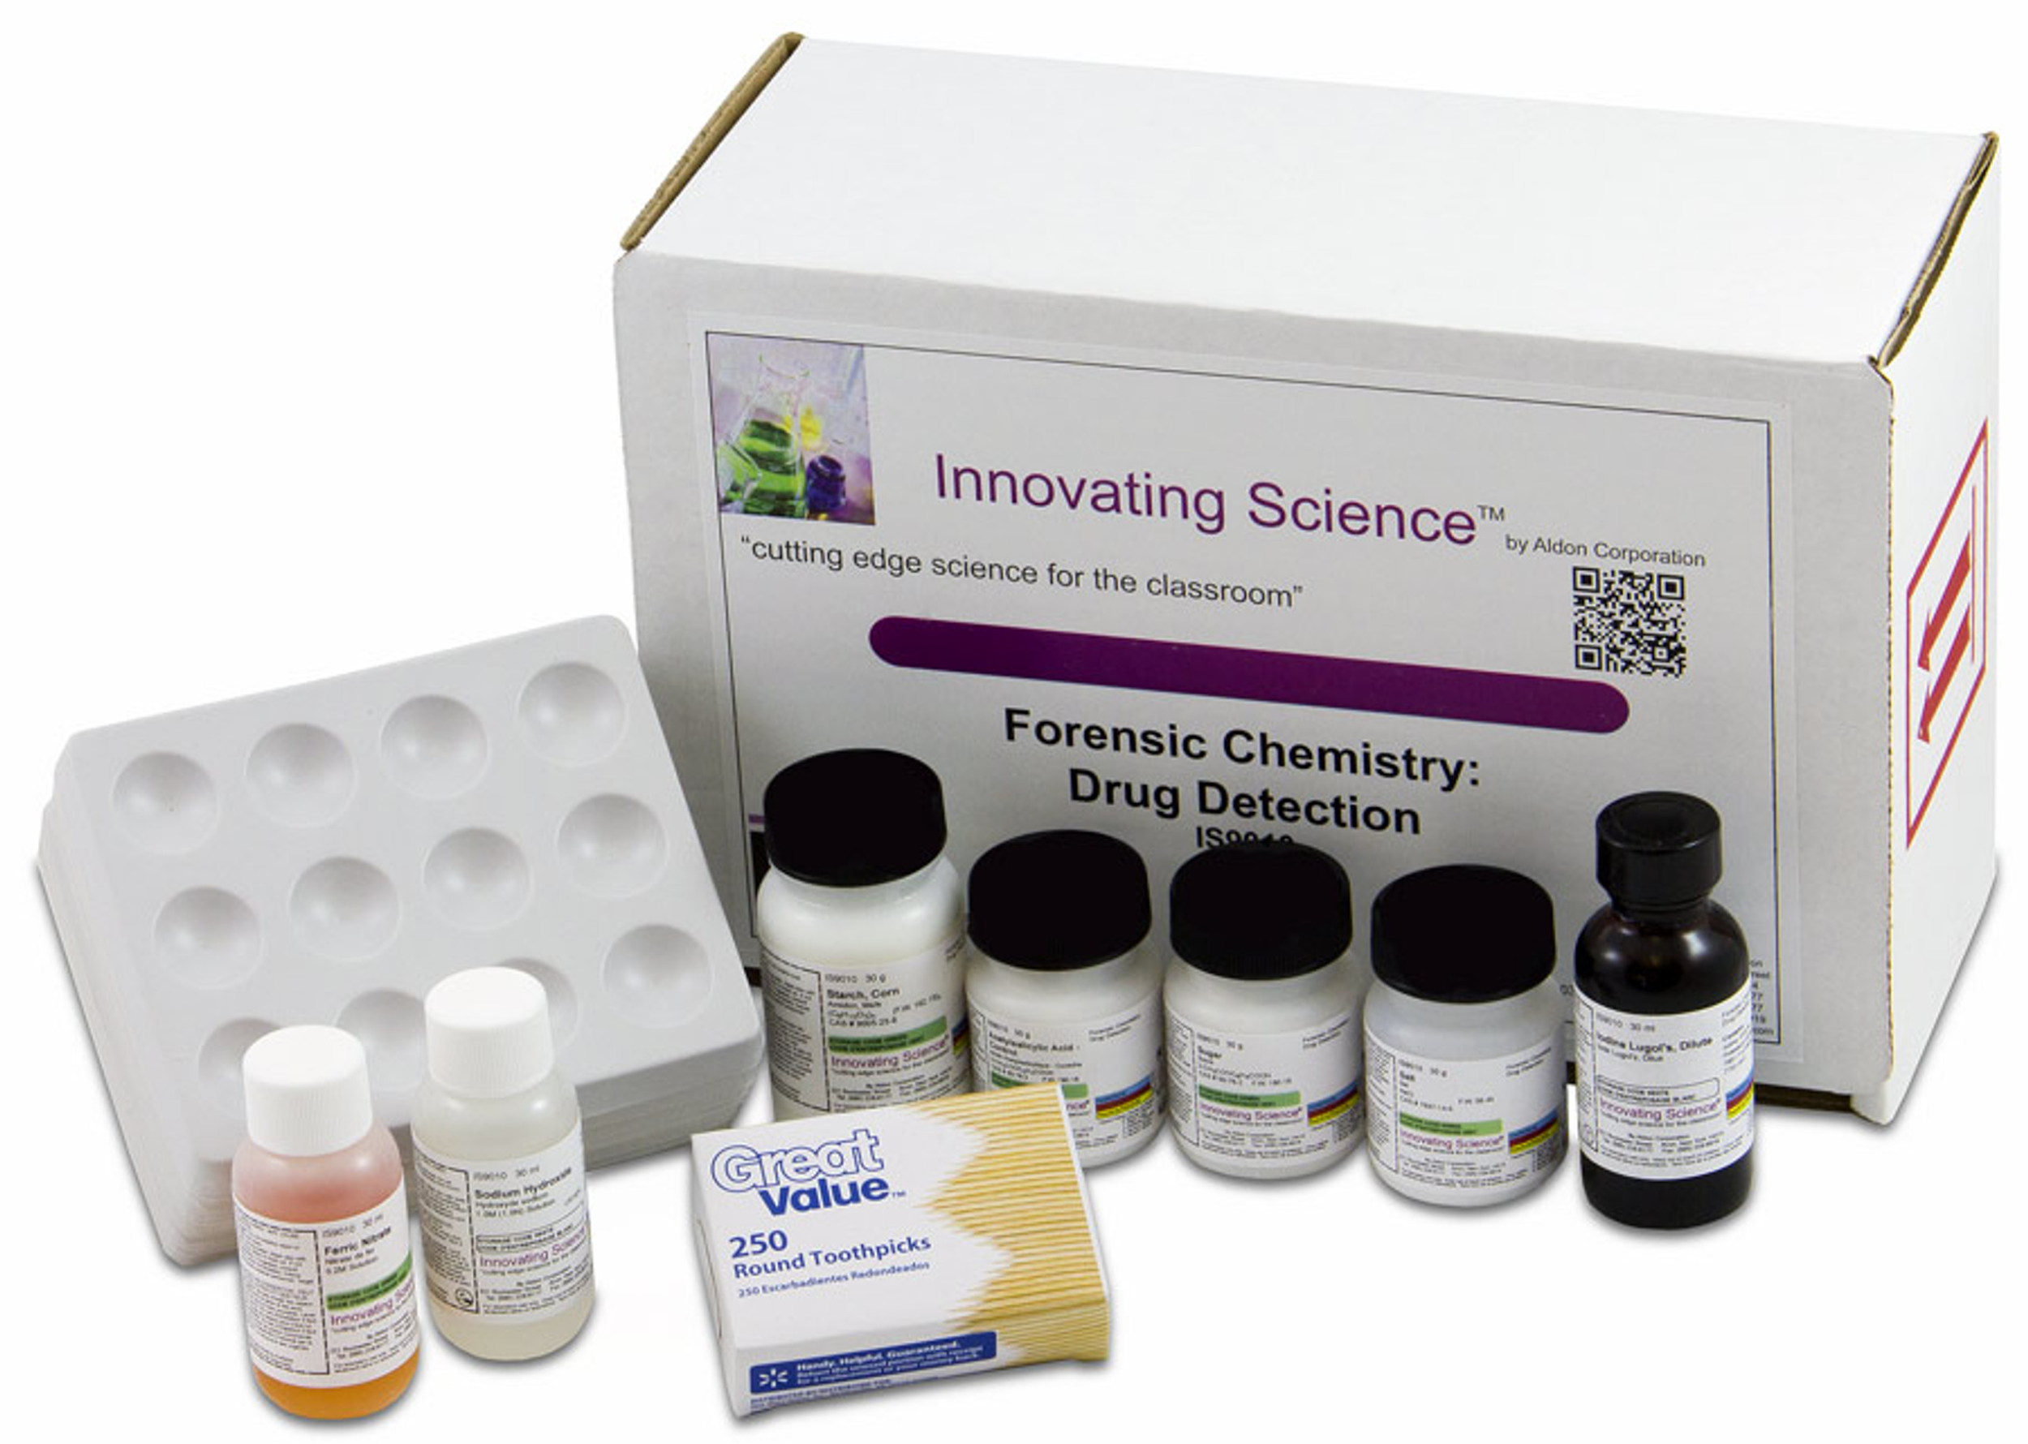
CHEMICAL & DRUG SCREENING KITS
Reagent kits for quick detection
Detects narcotics, toxicants, medications
On-site preliminary screening
Requires confirmatory GC-MS analysis (identify different substances within a test sample)
Saves time & resources

Slide 19
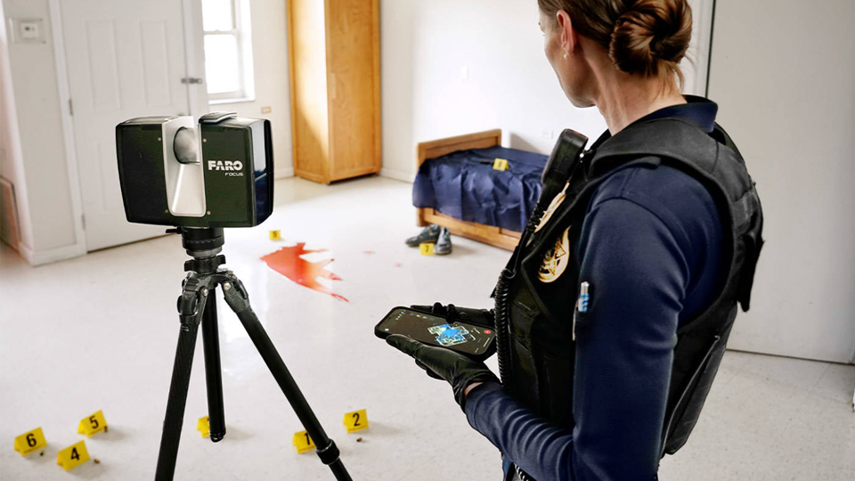
FORENSIC IMAGING & DOCUMENTATION
Digital cameras, 3D scanners, microscopes
High-resolution & 3D models
Preserves evidence integrity, aids in crime scene reconstruction, supports chain-of-custody & legal standards

Slide 20
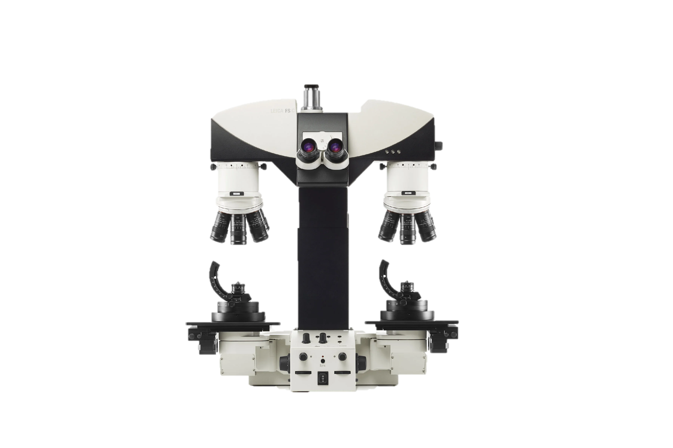
BALLISTICS & TOOLMARK DEVICES
Comparison microscopes for bullets & cases
3D imaging for surface analysis
Ballistic calculators for trajectory
Digital firearm databases
Matches weapons to crimes

Slide 21

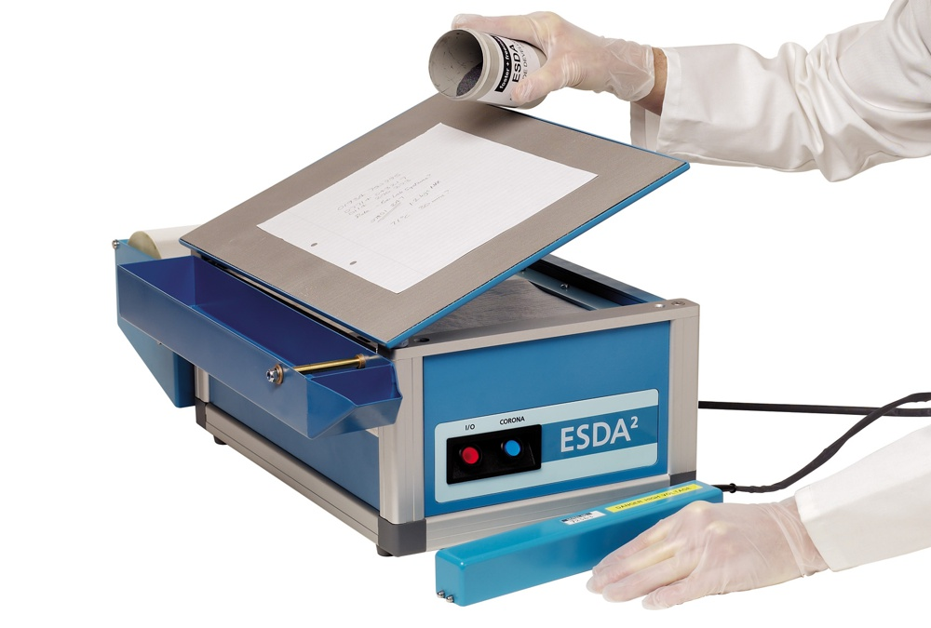
DOCUMENT EXAMINATION TOOLS
Stereoscopic Microscope
Comparison Microscopes
Video Spectral Comparator (VSC)
Electrostatic Detection Apparatus (ESDA)

Slide 22
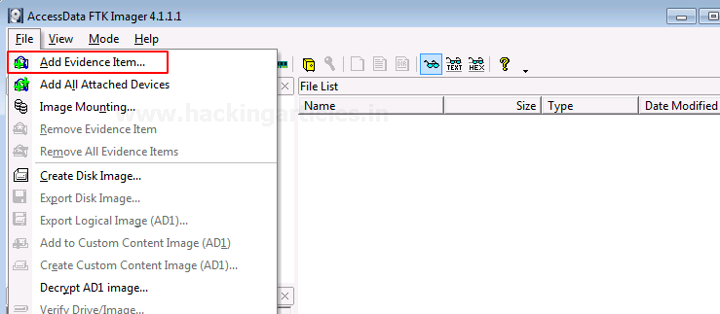
DIGITAL FORENSICS TOOLS
Data recovery & imaging tools
Keyword & timeline analysis
Hardware write blockers
Cybercrime & breach investigation
AI-driven digital evidence analysis
FTK, Autopsy, and EnCase

Slide 23

DNA ANALYSIS TOOLS
• PCR for DNA amplification
• STR Analysis for unique profiles
• Capillary electrophoresis systems
• DNA sequencing & Combined DNA Index System (CODIS)
• Highly reliable for identification

Slide 24
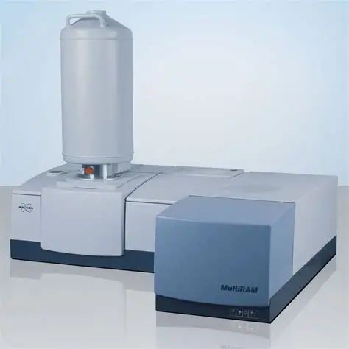
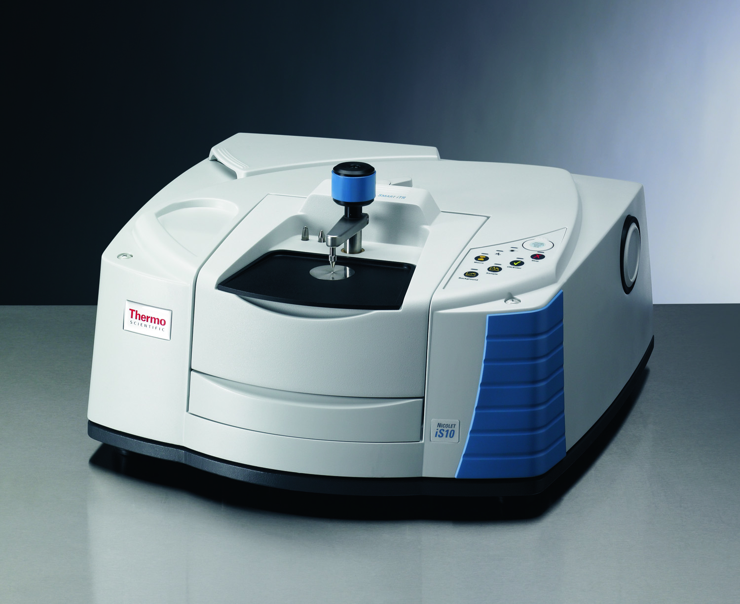
TRACE EVIDENCE ANALYSIS TOOLS
Spectrometers for chemical composition (FTIR and Raman spectroscopy)
Chromatographs (GC, LC) for mixtures
Microscopes for fibres, soil, paint
Links evidence to suspects & locations

Slide 25
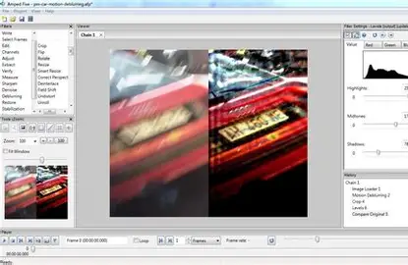
MULTIMEDIA FORENSIC TOOLS
Professionals in audio-video forensics rely on advanced software and tools tailored for evidence handling:
Spectrogram analysis (Visual representation of audio frequencies)
Waveform comparison (Identifies splicing, duplication, or deletion in recordings)
Adobe Audition and Audacity (audio editing)
Forensic Video Clarification tools like Amped FIVE
Frame-by-frame visual inspection software
Metadata analysis tools

Slide 26
EMERGING TECHNOLOGIES IN FORENSICS
Rapid DNA sequencing
AI & machine learning
3D imaging & 3D printing
Portable field devices
Future: Faster, more accurate, admissible evidence

Slide 27
CONCLUSION
Forensic tools ensure integrity & accuracy of investigations.
Cover wide domains: DNA, digital, ballistics, imaging, etc.
Emerging tech reshaping evidence analysis.
Strengthens justice system by providing reliable scientific proof.
REFERENCES
5 Essential Tools for Accurate Fingerprint Examination
21+ Forensic Questioned Document Instruments & Tools + Uses
9 Phases of Digital Forensics Explained | Tools, Steps, and Real-World Use Cases - Web Asha Technologies

Slide 28
Code of Conduct
The National Code of Professional Responsibility (“Code”) defines a framework for promoting integrity and respect for the scientific process among forensic science and forensic medicine service providers who must meet the requirements as discussed:
1. Accurately represent relevant education, training, experience, and areas of expertise
2. Be honest and truthful in all professional affairs including not representing the work of others as one’s own
3. Foster and pursue professional competency through such activities as training, proficiency testing, certification, and presentation and publication of research findings
4. Commit to continuous learning in relevant forensic disciplines and stay abreast of new findings, equipment, and techniques

Slide 29
Code of Conduct
5. Utilize scientifically validated methods and new technologies, while guarding against the use of unproven methods in casework and the misapplication of generally-accepted standards
6. Avoid tampering, adulteration, loss, or nonessential consumption of evidentiary materials
7. Avoid participation in any case where there is a conflict of interest
8. Conduct independent, impartial, and objective examinations that are fair, unbiased, and fit for-purpose
9. Make and retain contemporaneous, clear, complete, and accurate records of all examinations, tests, measurements, and conclusions, in sufficient detail to allow meaningful review and assessment by an independent professional proficient in the discipline
10. Ensure interpretations, opinions, and conclusions are supported by sufficient data and minimize influences and biases for or against any party
11. Do not render interpretations, opinions, or conclusions that are outside one’s proficiency or expertise

Slide 30
Code of Conduct
12. Prepare reports and testify using clear and straightforward terminology, clearly distinguishing data from interpretations, opinions, and conclusions and disclosing known limitations that are necessary to understand the significance of the findings
13. Do not alter reports or other records or withhold information from reports for strategic or tactical advantage
14. Appropriately document and, if appropriate, inform management or quality assurance personnel of nonconformities and breaches of law or ethical standards
15. Once a report is issued, communicate fully with investigators, prosecutors, defense attorneys, and other experts, except when instructed that a legal privilege or law prevents disclosure
16. Appropriately inform affected recipients (either directly or through proper management channels) of all nonconformities or breaches of law or ethical standards that adversely affect a previously issued report or testimony and encourage others to inform all relevant stakeholders, including affected professional and legal parties, victim(s) and defendant(s)

Slide 31
Code of Conduct
Reference: https://www.bing.com/ck/a?!&&p=d7614b84d7f8c49fe4c2e871477f983c118fc2dc8ececf2118ba8bc6b37f2067JmltdHM9MTc1ODQxMjgwMA&ptn=3&ver=2&hsh=4&fclid=367dcaaf-60e2-6dc0-398a-d93461506cc3&psq=The+National+Code+of+Professional+Responsibility+for+Forensic+Science+and+Forensic+Medicine+Service%c2%a0&u=a1aHR0cHM6Ly93d3cuanVzdGljZS5nb3YvbmNmcy9maWxlLzc5NTMxMS9kbD9pbmxpbmU

